Slide 1
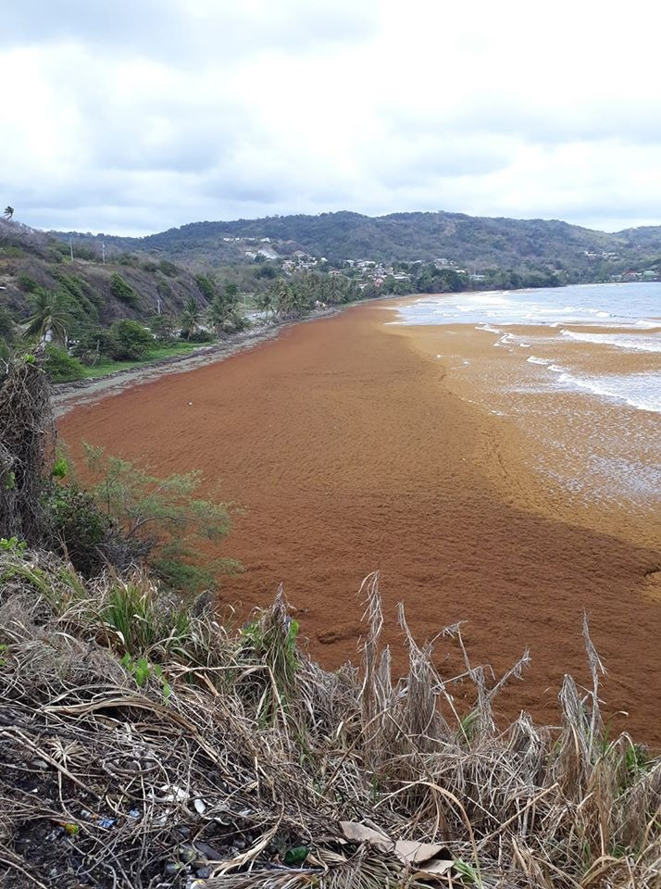
Trinidad and Tobago: National Response to Sargassum
Presented by: Rahanna Juman, Institute of Marine Affairs
Joint Meeting LBS and Sargassum Working Groups
March 2025

Slide 2
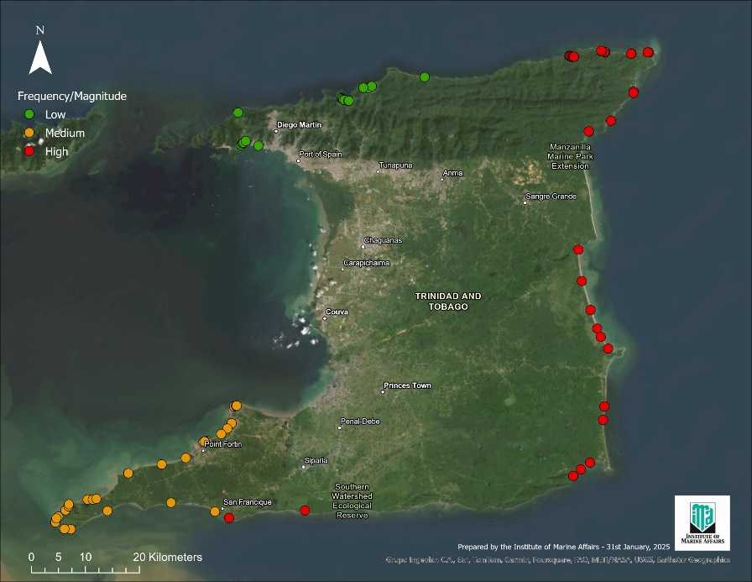
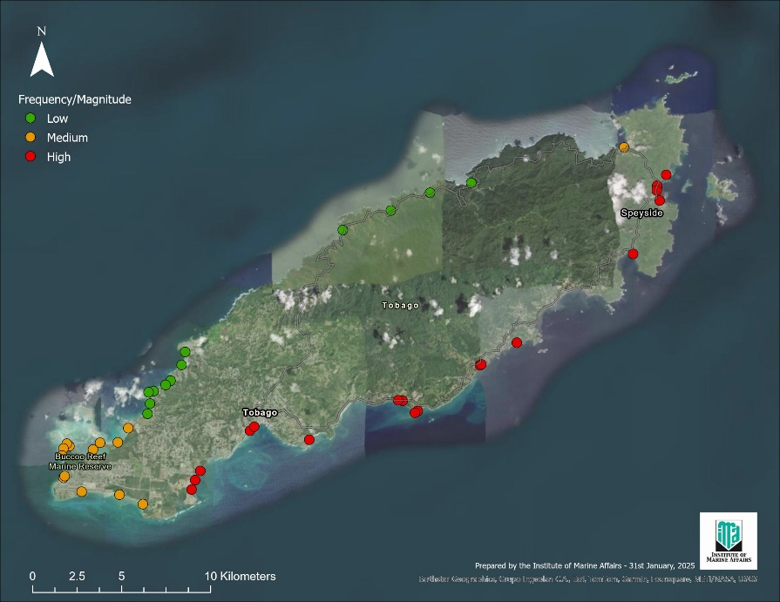
Sargassum Influx
Since 2011, large quantities of Sargassum seaweed have been washing ashore in Trinidad and Tobago.
In Trinidad, communities on the north-east and south-east coasts from Matelot to Guayaguayare have been impacted. More recently we received report for the southwest coast-Los Iros Bay
Along Tobago’s Atlantic coast mats up to 0.6m thick have been observed in Tyrel’s Bay, Pinfold Bay, King’s Bay, Hope Beach, Delaford Bay, Goldsborough Bay, Kilgwyn and Little Rockly Bay.

Slide 3
National Response to Sargassum Influx
In 2015, the Institute of Marine Affairs (IMA) in conjunction with the UNDP Global Environment Facility Small Grants Programme (GEF-SGP) consulted with key stakeholders to develop a National Sargassum Response Plan.
The Draft National Sargassum Response Plan was completed in 2016.

Slide 4
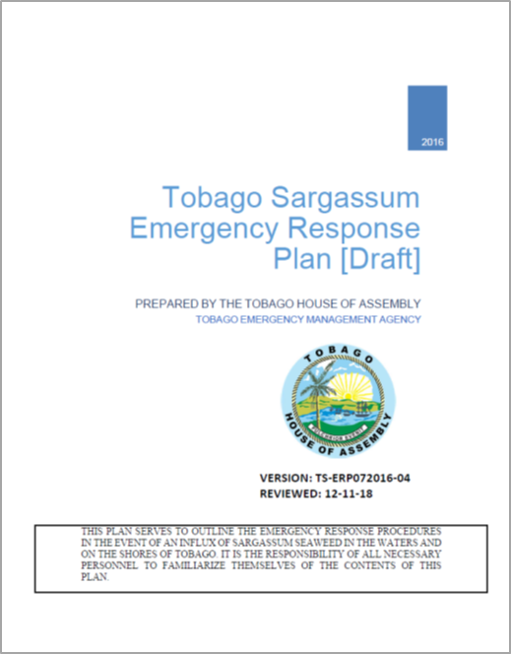
National Response to Sargassum Influx
The Division of Infrastructure Quarries and the Environment (DIQE) in conjunction with the Tobago Emergency Management Agency (TEMA) consulted with key stakeholders to develop a Sargassum Emergency Response Plan, specifically for Tobago.
The Draft Tobago Sargassum Emergency Response Plan was completed in 2016 and updated in 2018.

Slide 5
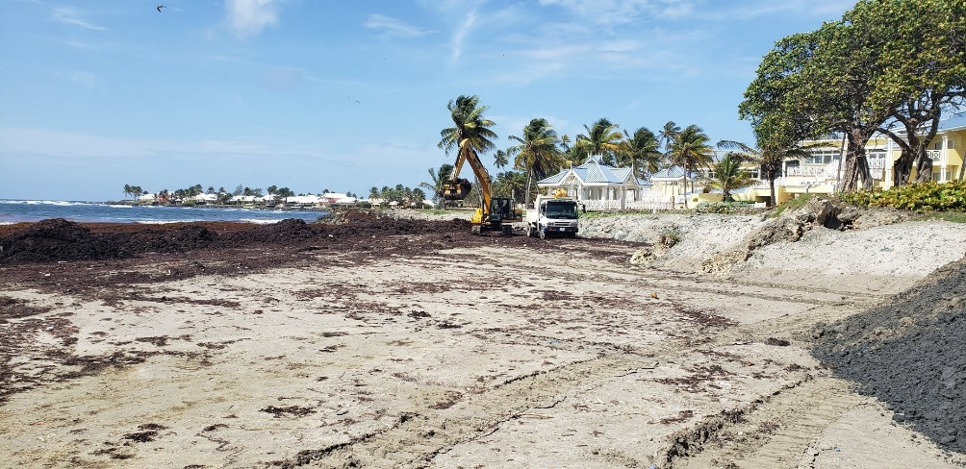
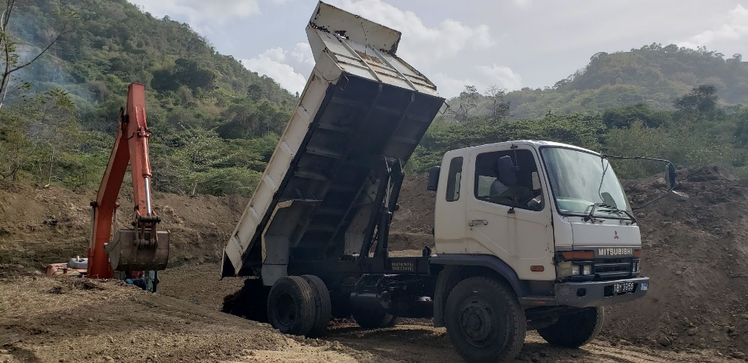
National Response to Sargassum Influx
Collect, Remove and Dispose
Continued use of heavy equipment
Clean-up Cost
In 2015, clean-up cost in Speyside
amounted to close to $4 million
Research
UWI – STA (Sargassum extract – bio stimulant and bioplastic)

Slide 6
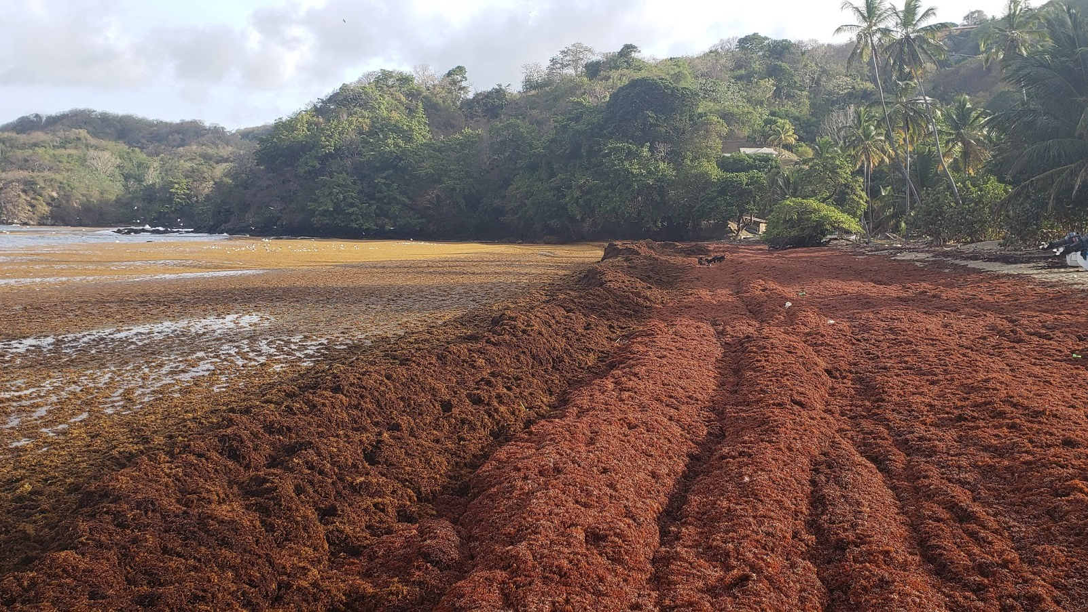
The project aims to support the enhancement of national capacity to collect, remove and dispose of sargassum seaweed by providing equipment, expertise and technical knowledge to countries.
Beneficiaries: Barbados, St. Kitts and Nevis, St. Lucia, St. Vincent and the Grenadines, and Trinidad and Tobago.
Duration: 3 years (2022-2025)
Value: US$12,339,473.00
Trinidad and Tobago will benefit from an allocation of US$1.99 M, specifically for equipment.
National multi-sectoral project steering committee
Improving National Sargassum Management Capacities in the Caribbean

Slide 7
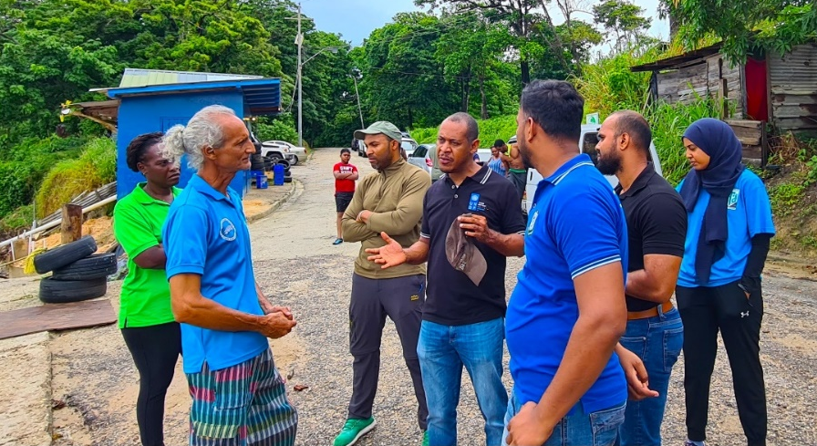
National Sargassum Task Force
National Sargassum Task Force is to act as a national, interagency coordination mechanism for the implementation of Sargassum Response for Trinidad and Tobago.
  offer guidance and assistance to Regional Corporations of the Ministry of Rural Development and Local Government, the Tobago House of Assembly and other support agencies that will serve as the first responders for clean-up efforts, and will ensure alignments with the national response framework.
  be responsible for establishment of an early warning system in order to notify coastal stakeholders and mobilise the requisite resources to deal with the impending Sargassum incursion.
  strategize and make recommendations on priority areas to store the seaweed and concentrate clean-up efforts, training and public awareness and education.
  seek to encourage meaningful collaboration and communication among key stakeholders at all levels and throughout the process, from early warning to public education and awareness.
  provide oversight over the development of a research and monitoring agenda that will facilitate improvement in managing the impacts of future occurrences of this natural disaster and inform the handling, disposal, storage, and utilisation of Sargassum products.

Slide 8
Deliverables
Vulnerability assessment study with respect to Sargassum landfall
Coordination for the provision of early warning to coastal stakeholders
Development of a communication strategy
Management of a coordinated-response and clean-up in affected beaches/communities
Oversight for the disposal of and/or approaches for the utilisation of plant material
Oversight and establishment of a research and monitoring agenda
Implementation of a training and public education and awareness programme
Recommendations on institutional arrangements for coordination of Sargassum related events

Slide 9
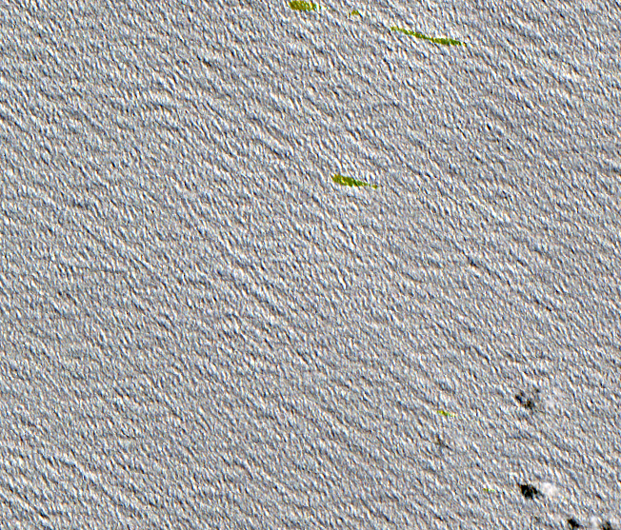
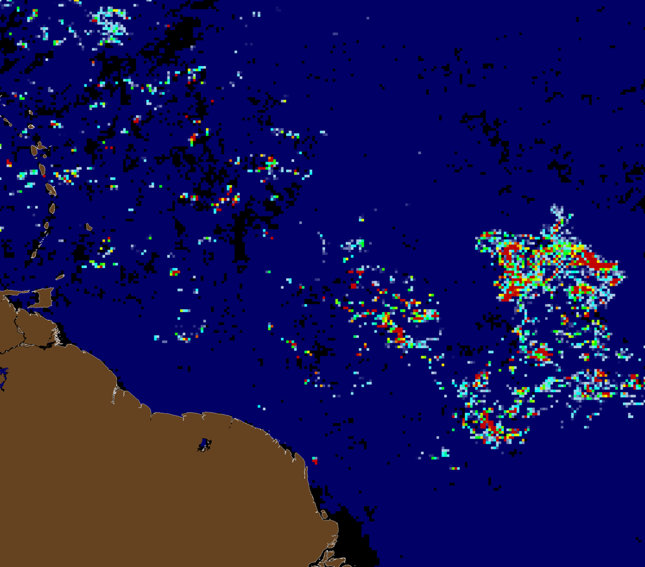
Sargassum Monitoring and Detection Programme with Remote Sensing
The IMA is developing a satellite remote sensing detection and monitoring programme for the influx of sargassum
The detection is facilitated using satellite imagery (Sentinel 2A & Sentinel 2B) – we conducted a pilot study for a period of three (3) months in 2024
Sargassum was detected, which radiates a “greenish/yellowish” color on satellite imagery
We are exploring the potential to develop an “early warning system” for influxes through trajectory modelling utilizing satellite imagery

Slide 10
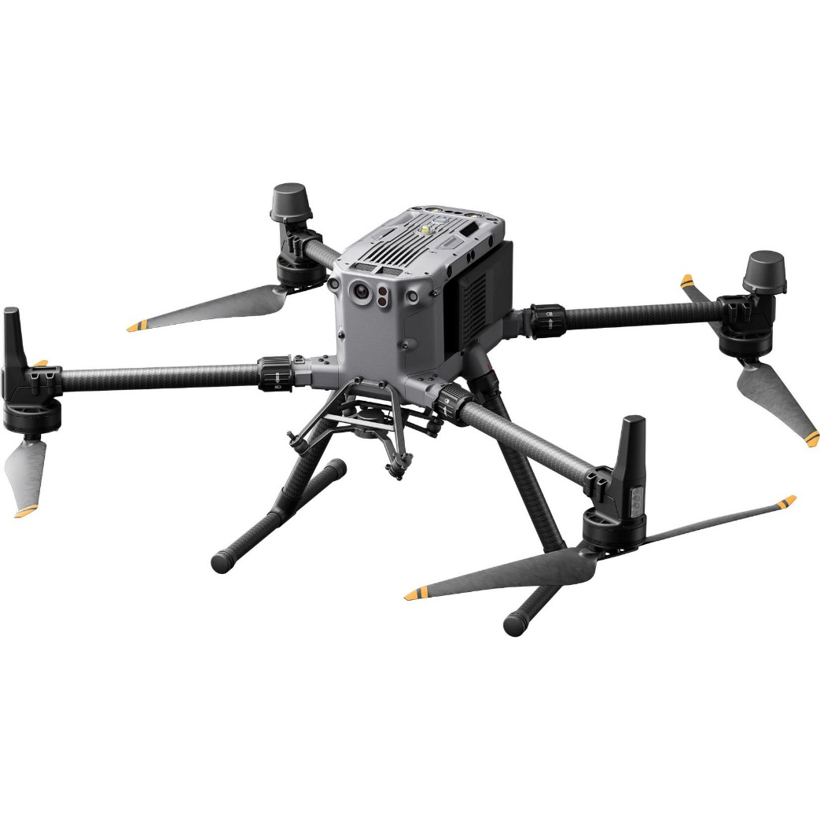
Potential for Ground Truthing and Quantification of Sargassum Utilizing UAS Technology
The IMA recently received training on UAS operations for the DJI Matrice 350 (LiDAR and RTK)
Interested in exploring the potential of UAS technology towards quantification and volumetric analysis of nearshore Sargassum influxes
UAS technology supports this type of analysis and compliments the utilization of satellite remote sensing for detection and long-term monitoring
Citizen science will also be incorporated- through the implementation of beach signage with QR codes to facilitate reports of Sargassum on beaches

Slide 11
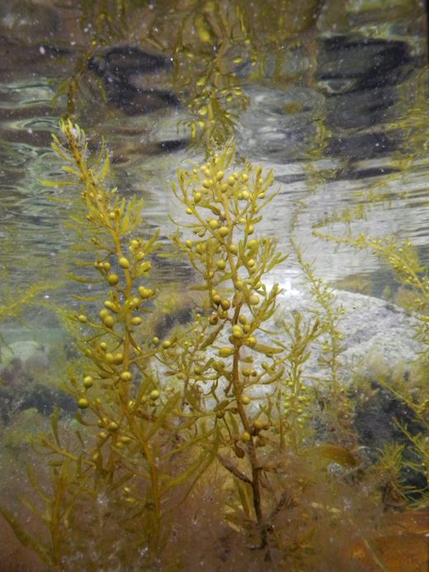
Thanks for your attention

